Slide 1

Regularization
INFO 251: Applied Machine Learning

Slide 2
Announcements
Reminder: Next week’s classes on Zoom online
Assignment 3 due next week
Quiz 1 scheduled for March 1, first ~40 minutes of class
10-15 multiple choice and short-answer questions
See piazza for details on quiz timing

Slide 3
Course Outline
Causal Inference and Research Design
Experimental methods
Non-experiment methods
Machine Learning
Design of Machine Learning Experiments
Linear Models and Gradient Descent
Non-linear models
Neural models
Unsupervised Learning
Practicalities, Fairness, Bias
Special topics

Slide 4
Key Concepts (last lecture)
Cost Functions
Gradient Descent
Local and global minima
Convex functions
Incremental vs. Batch GD
Learning rates
Feature scaling

Slide 5
Outline
Overfitting
Regularization: intution
Ridge
Lasso

Slide 6
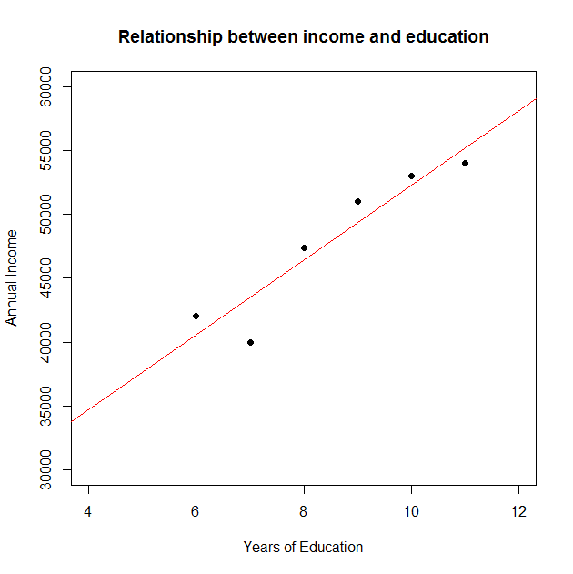
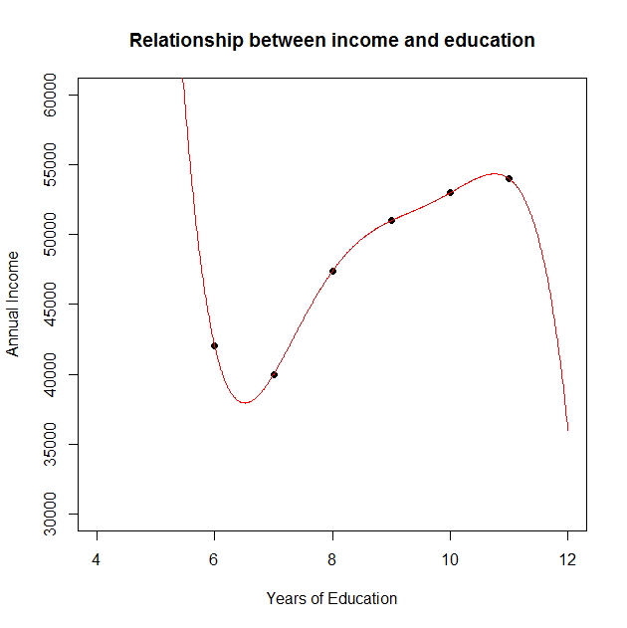
Overfitting revisited
Overfitting: If we have too many features, our model may fit the training set very well, but fail to generalize to new examples
wages_{i}=α+β*educ_{i}+error_{i}
wages_{i}=α+β₁*educ_{i}+… +β₅*educ_{i}⁵ +error_{i}

Slide 7
Overfitting: Solutions
Later in the course:
Feature selection
Model selection
Dimensionality reduction
Now: Regularization
For instance, ridge regularization: Keep all the features, but reduce magnitude of specific parameters

Slide 8

Regularization: Intuition
Occam’s Razor
A principle of parsimony, economy, or succinctness used in problem-solving. It states that among competing hypotheses, the hypothesis with the fewest assumptions should be selected.
See: Domingos, P. The role of Occam’s razor in knowledge discovery. Data Mining and Knowledge Discovery 3 (1999), 409–425.
Notes:
William of Ockham was a 14th century English friar and philosopher particularly concerned with logic.
The Occam’s razor maxim, as interpreted by the 20th century philosopher Bertrand Russell says that we should always opt for an explanation in terms of the fewest possible factors.
This idea is important because it addresses the central problem of machine learning: generalization
It is coherent, for instance, to add the involvement of leprechauns to any explanation, but Occam's Razor would prevent such additions, unless they were necessary.

Slide 9

Regularization: Intuition
Idea: Add a cost penalty for additional complexity in the model
Example: polynomial regression
Model: $Y_{i}=θ_{0}+θ_{1}X_{i}+ …+θ_{k}X_{i}^{k}$
Parameters: $θ_{0},…,θ_{k}$
Original “Cost”: $J\left(θ\right)= \frac{1}{2N}\sum_{i=1}^{N}{{\left(θ_{0}+θ_{1}X_{i}+ …+θ_{k}X_{i}^{k}−Y_{i}\right)}^{2}}$
wages_{i}=α+β*educ_{i}+error_{i}
wages_{i}=α+β₁*educ_{i}+… +β₅*educ_{i}⁵ +error_{i}

Slide 10

Regularization: Intuition
Original Cost
$J\left(θ\right)= \frac{1}{2N}\sum_{i=1}^{N}{{\left(θ_{0}+θ_{1}X_{i}+ …+θ_{k}X_{i}^{k}−Y_{i}\right)}^{2}}$
Intuitive Goal
$J\left(θ\right)= \frac{1}{2N}\sum_{i=1}^{N}{{\left(θ_{0}+θ_{1}X_{i}+ …+θ_{k}X_{i}^{k}−Y_{i}\right)}^{2}+C(θ_{1},…,θ_{k})}$
Penalized (Regularized) Cost
$J\left(θ\right)= \frac{1}{2N}\left[\sum_{i=1}^{N}{{\left(θ_{0}+θ_{1}X_{i}+ …+θ_{k}X_{i}^{k}−Y_{i}\right)}^{2}}+λ\sum_{j=1}^{k}{{\left|θ_{j}\right|}^{2}}\right]$
penalty
“Ridge”
coefficient
Regularization parameter

Slide 11
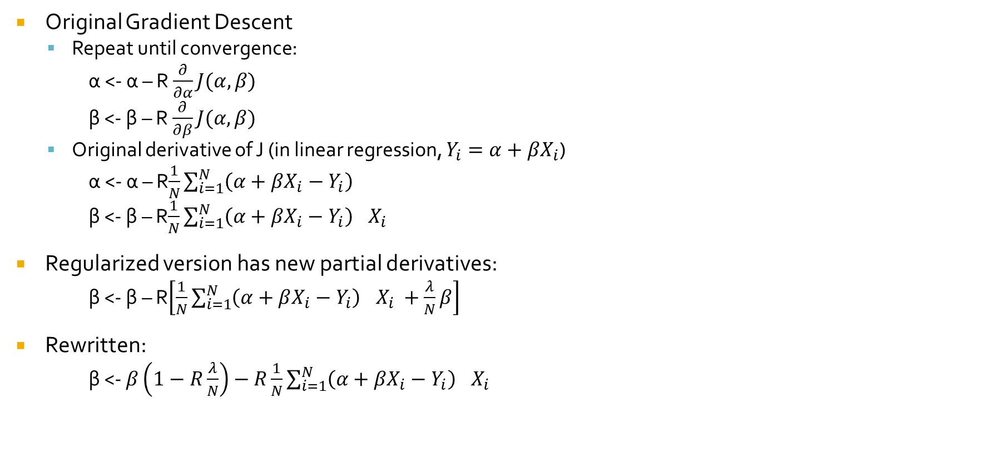
Regularization and Linear Regression
Original Gradient Descent
Repeat until convergence:
α <- α – R $\frac{∂}{∂α}J(α, β)$
β <- β – R $\frac{∂}{∂β}J(α, β)$
Original derivative of J (in linear regression, $Y_{i}=α+βX_{i}$)
α <- α – R$\frac{1}{N}\sum_{i=1}^{N}{{\left(α+βX_{i}−Y_{i}\right)}^{}}$
β <- β – R$\frac{1}{N}\sum_{i=1}^{N}{{\left(α+βX_{i}−Y_{i}\right)}^{}X_{i} }$
Regularized version has new partial derivatives:
β <- β – R$\left[\frac{1}{N}\sum_{i=1}^{N}{{\left(α+βX_{i}−Y_{i}\right)}^{}X_{i} }+\frac{λ}{N}β\right]$
Rewritten:
β <- $β\left(1−R\frac{λ}{N}\right)−R\frac{1}{N}\sum_{i=1}^{N}{{\left(α+βX_{i}−Y_{i}\right)}^{}X_{i} }$
Notes:
Note: we’re not adding regularization penalty to alpha – more on this later

Slide 12
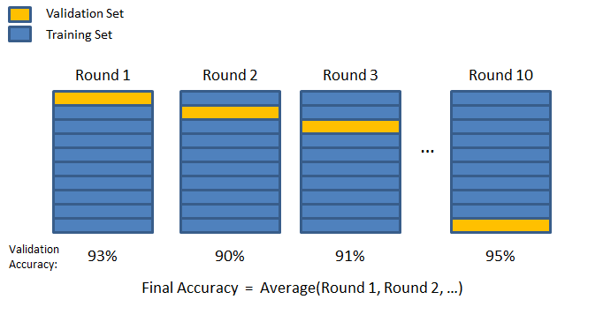

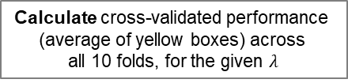

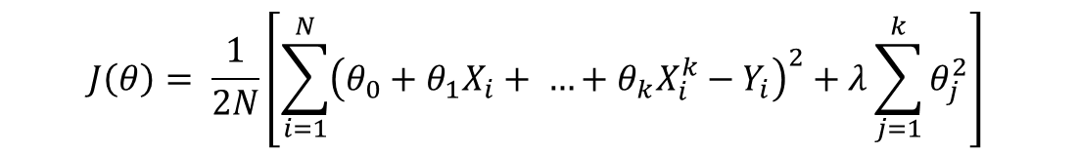
Regularization: Some notes
How to select $λ$?
Cross validation!
Choose $λ$ that minimizes cross-validated performance (yellow boxes)
i.e., repeat dark blue process for a variety of candidate values of $λ$
$$J\left(θ\right)= \frac{1}{2N}\left[\sum_{i=1}^{N}{{\left(θ_{0}+θ_{1}X_{i}+ …+θ_{k}X_{i}^{k}−Y_{i}\right)}^{2}}+λ\sum_{j=1}^{k}{θ_{j}^{2}}\right]$$
Cross-
validation
training
set
Calculate cross-validated performance
(average of yellow boxes) across
all 10 folds, for the given $λ$
Choose new $λ$
Test
set
Test
performance

Slide 13
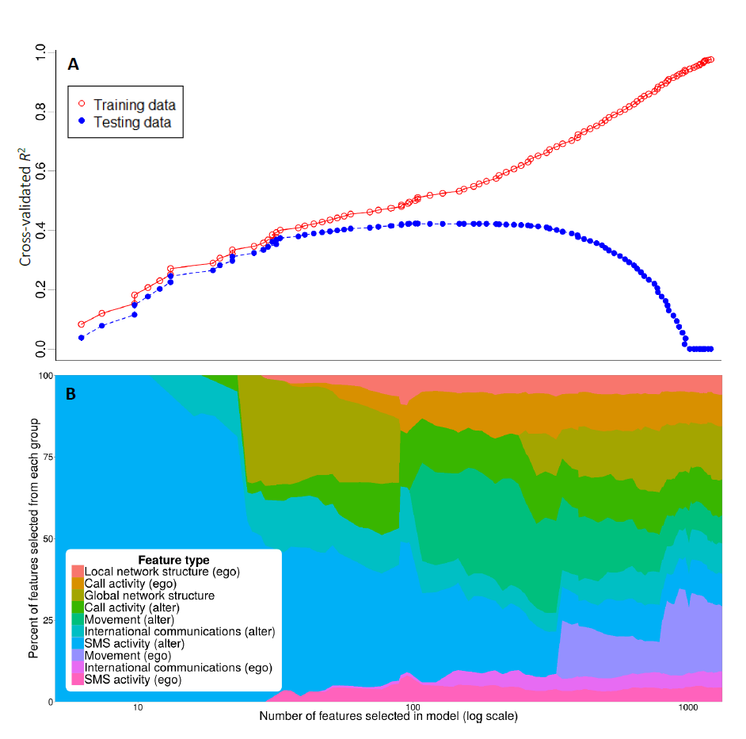


Regularization: Some notes
Example
← Large $λ$
Small$λ$ →

Slide 14
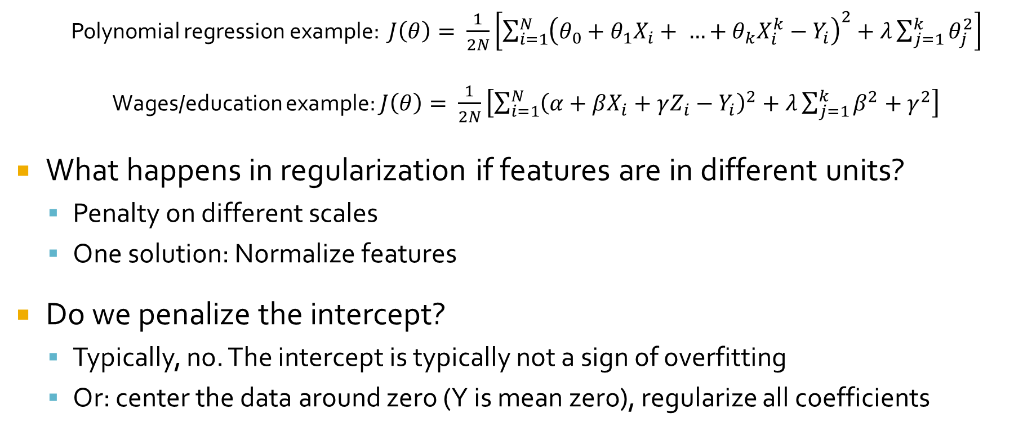
Regularization: Some notes
Polynomial regression example: $J\left(θ\right)= \frac{1}{2N}\left[\sum_{i=1}^{N}{{\left(θ_{0}+θ_{1}X_{i}+ …+θ_{k}X_{i}^{k}−Y_{i}\right)}^{2}}+λ\sum_{j=1}^{k}{θ_{j}^{2}}\right]$
Wages/education example: $J\left(θ\right)= \frac{1}{2N}\left[\sum_{i=1}^{N}{{\left(α+βX_{i}+γZ_{i}−Y_{i}\right)}^{2}}+λ\sum_{j=1}^{k}{β^{2}+γ^{2}}\right]$
What happens in regularization if features are in different units?
Penalty on different scales
One solution: Normalize features
Do we penalize the intercept?
Typically, no. The intercept is typically not a sign of overfitting
Or: center the data around zero (Y is mean zero), regularize all coefficients
Notes:
The advantage of centering is that all coefficients can be regularized in the same way (in code). This is often bc implementation often relies on matrix algebra, and it can be simpler to implement

Slide 15
Outline
Regularization
Ridge and Lasso
Logistic regression (inference)
Logistic regression (prediction and gradient descent)
Support vector machines
Kernels

Slide 16
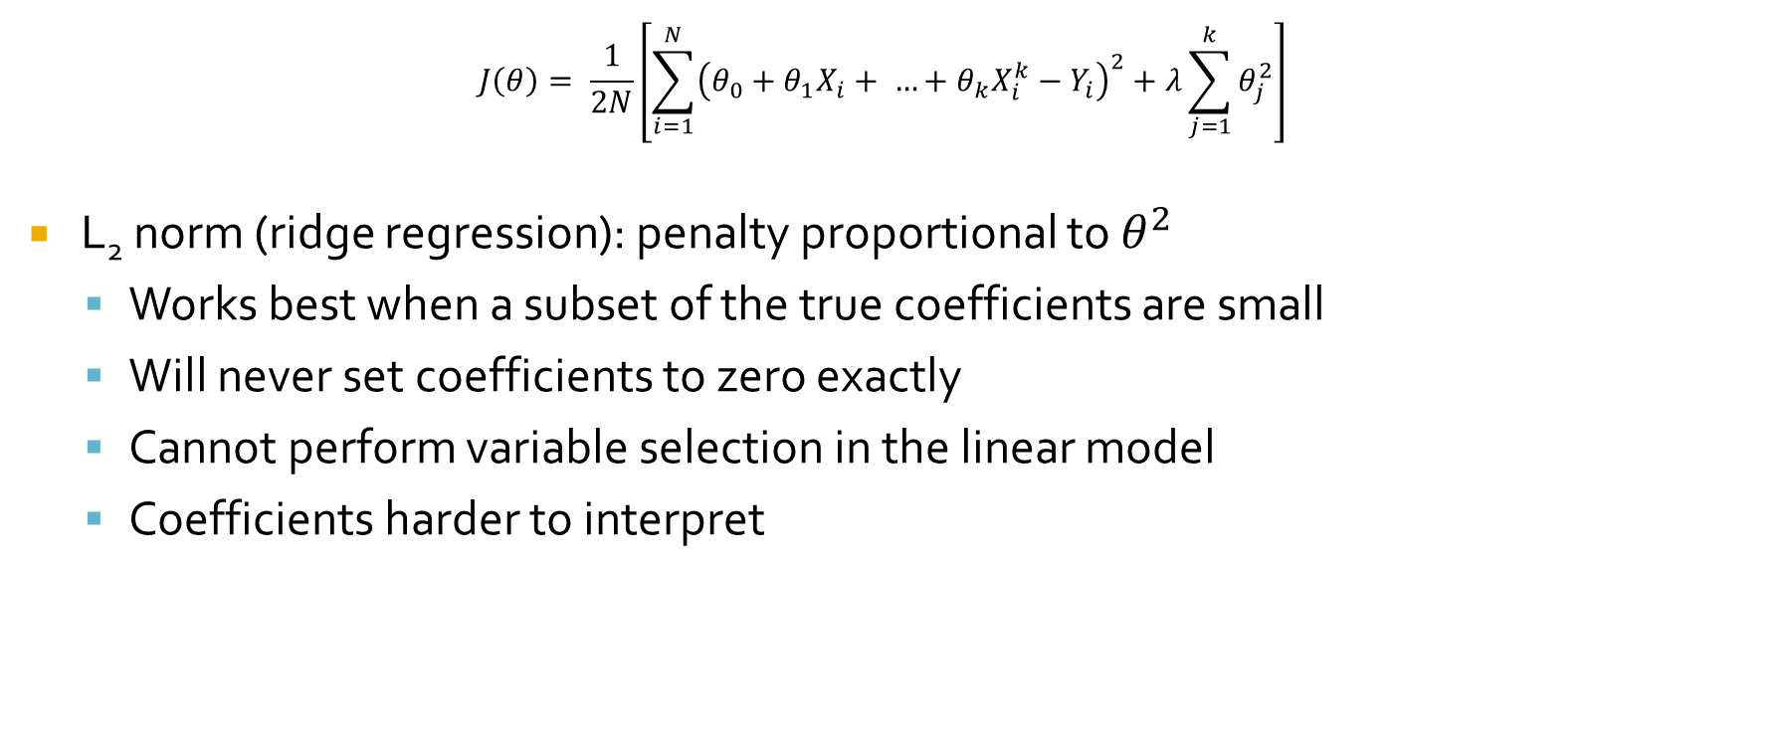
“Ridge”
$$J\left(θ\right)= \frac{1}{2N}\left[\sum_{i=1}^{N}{{\left(θ_{0}+θ_{1}X_{i}+ …+θ_{k}X_{i}^{k}−Y_{i}\right)}^{2}}+λ\sum_{j=1}^{k}{θ_{j}^{2}}\right]$$
L₂ norm (ridge regression): penalty proportional to $θ^{2}$
Works best when a subset of the true coefficients are small
Will never set coefficients to zero exactly
Cannot perform variable selection in the linear model
Coefficients harder to interpret

Slide 17
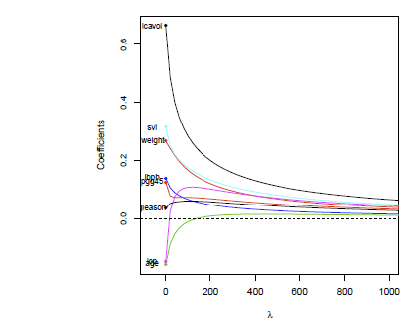
Ridge: Coefficient plot
Source: Ryan Tibshirani

Slide 18
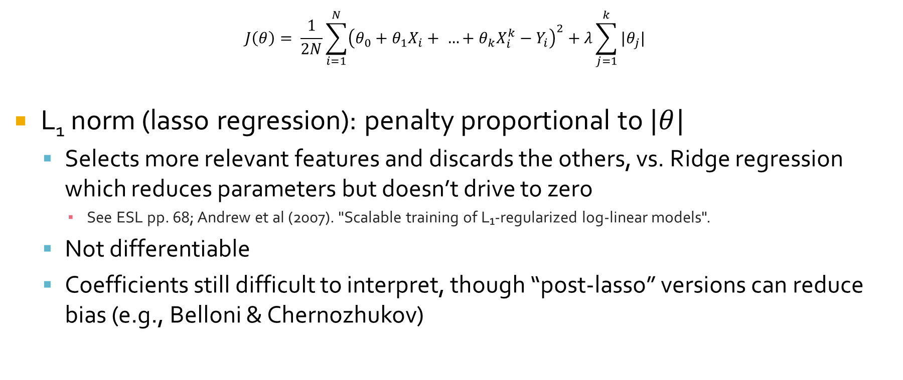
LASSO
$$J\left(θ\right)= \frac{1}{2N}\sum_{i=1}^{N}{{\left(θ_{0}+θ_{1}X_{i}+ …+θ_{k}X_{i}^{k}−Y_{i}\right)}^{2}}+λ\sum_{j=1}^{k}{|θ_{j}|}$$
L₁ norm (lasso regression): penalty proportional to $|θ|$
Selects more relevant features and discards the others, vs. Ridge regression which reduces parameters but doesn’t drive to zero
See ESL pp. 68; Andrew et al (2007). "Scalable training of L₁-regularized log-linear models".
Not differentiable
Coefficients still difficult to interpret, though “post-lasso” versions can reduce bias (e.g., Belloni & Chernozhukov)

Slide 19
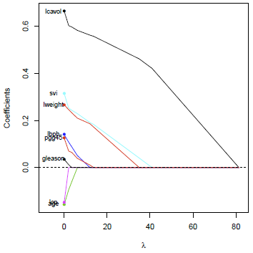
LASSO: Coefficient plot
Least Absolute Selection and Shrinkage Operator
See ESL section 3.4
Tibshirani (1996), “Regression Shrinkage and Selection via the Lasso"

Slide 20
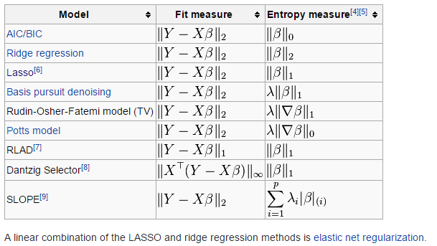
Other forms of Regularization

